Slide 1

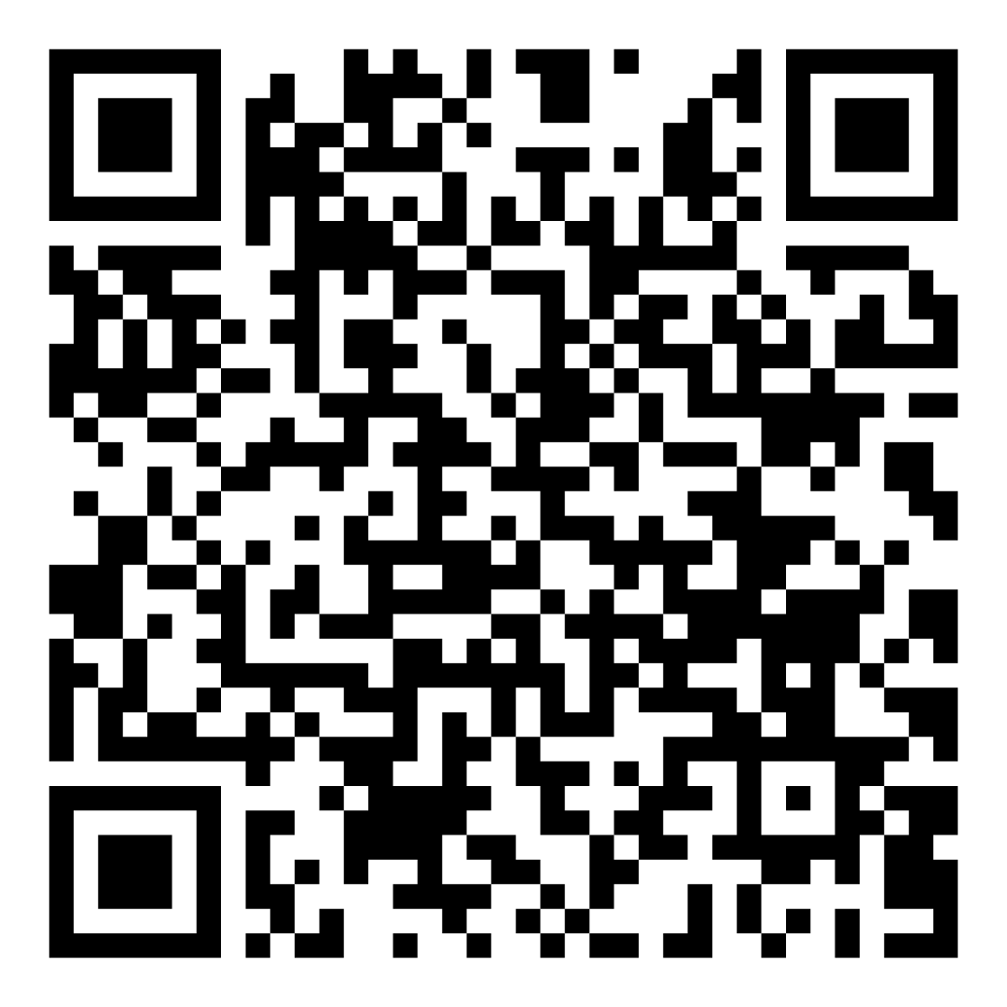


Realising the full potential of your FM services
LitmusFM
Consultancy Services Ltd
The AUDE Joint South-West/South-East and London Regional Director's Meeting

Slide 2
Welcome and Introduction by Tom
John Brownless – Joint Managing Director LitmusFM
Working with Tom and his Team at AUB
New Partnership at AUDE
Notes:
Tom to open the session.

Slide 3
The Market Sector
2024
2024 -2025
2025 -2027
Notes:
John to discuss the changes in the sector.

Slide 4
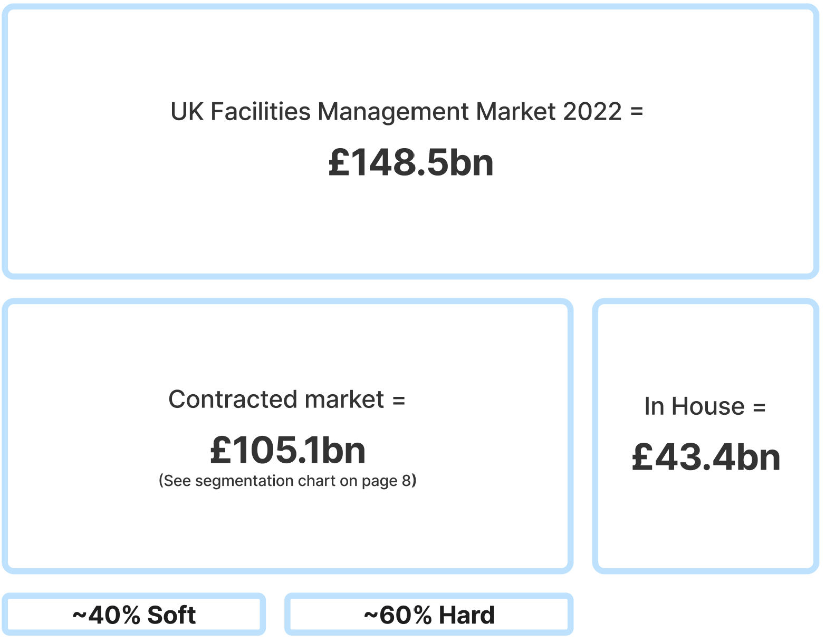
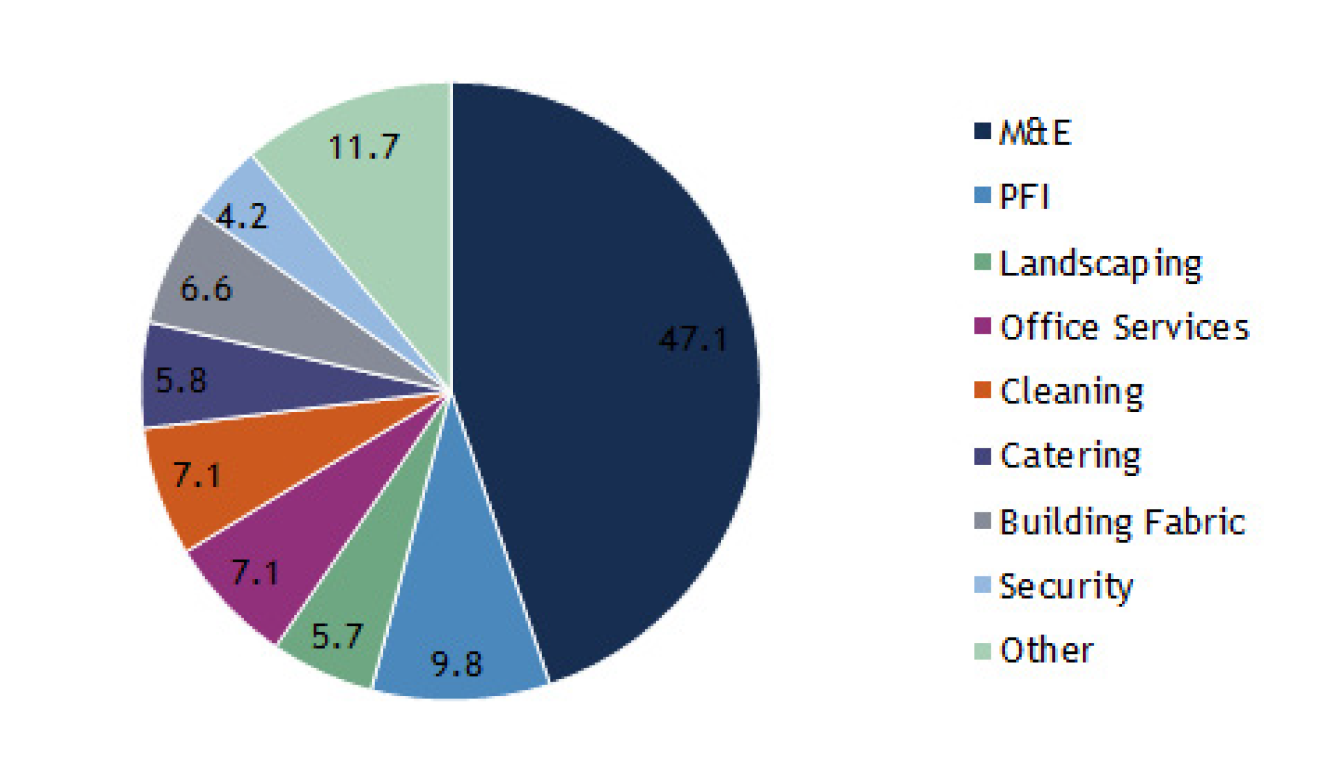
Facilities Management Market Overview
UK Facilities Management Market 2023
£234.6bn
47.1
Contracted Market =
£165.8bn
In-House
£68.8bn
Notes:
John to discuss the market values.

Slide 5






Competitive Landscape and Market Evolution
REAL ESTATE
PROPERTY MANAGEMENT
CBRE
JLL
INTEGRATED FACILITIES MANAGEMENT
SODEXO
COMPASS
JOHNSON
CONTROLS
MITIE
FOOD SERVICES
SOFT SERVICES
HARD FM
Different models
Investment to enlarge service capabilities and to expand footprint
Regional players as well
Notes:
John to discuss how the market is changing, the M&A’s and the larger organisation movements.

Slide 6







Typical Route to reducing costs
IFM/TFM
Full outsourcing of wide-ranging noncore activities and management
One partner per site that typically performs major services with its own staff
Synergies in delivery and management
Bundled
Standardized
Bidding out multiple services for one supplier to deliver more than one service in exchange for an extra rebate
Out-tasked
Savings
In House
Alignment of service levels across sites to lowest acceptable level, with similar employee treatment
Re-sourcing of noncore tasks on a case-by-case basis
Own staff
performing noncore services
Consolidation & Re-sourcing
Notes:
John: How consolidation and resourcing can generate savings.

Slide 7
Typical Division of Technical Services
Outsource
Client Specific
In House
Non-Regulated Space
Regulated Space
Specialist Equipment
Non-Regulated Services
Regulated Services
Critical Assets
Low / No Business Interruption
Clear Definitions required
Service Providers unwilling to accept consequential loss
Critical Business Interruption
Notes:
John: Business specific sectors.

Slide 8
TFM or IFM Models
Reception
Security
Fabric and FFE
PPM
Meeting Rooms
Soft Services
Food
Helpdesk
Moves and Changes
Hard Services
Reactive
Grounds / Pest
Cleaning
Minor Projects
Asset Mgmnt
Notes:
John: Typical models.

Slide 9
Typical Bundled Approach
Helpdesk
Reception
Security
Fabric and FFE
PPM
Meeting Rooms
Soft Services
Food
Moves and Changes
Hard Services
Reactive
Grounds / Pest
Cleaning
Minor Projects
Asset Mgmnt
Notes:
John: Typical models, the move away to splitting the soft and hard, enabling SMEs to join.

Slide 10
The Route to Designing your FM
STAGE A
STAGE B
STAGE C
STAGE D
STAGE E
A
B
C
D
E
Data Gathering
Specifications
Asset Management
Financial Model
KPIs / SLAs
Occupied space
Population
Population distribution
Supply Chain
Building age
Owned / Leased?
Existing spend/budget.
Output V Input?
Aligned operating model
Consistency to the degree of outsourcing
Consistent data in consistent CMMS
Transferable data
Clarity on data ownership
Consistent approach to asset/system categorisation
Core Model
Approach to demand-driven activity
Approach to variations
Budget alignment in Finance Systems (e.g., SAP )
Lagging or leading indicators?
Balance between forward-looking and historic
Risk and Reward?
Link to standardised specifications
Notes:
The importance of data.

Slide 11
The LitmusFM phased review approach
Phase | Title | Activities
❶ | Preparation | Project Kick-off Meeting Confirmation of Project Scope & Timetable Data gathering/Information required
❷ | Research | Review the data and documentation gathered in Phase 1 & prepare clarification questions Stakeholder engagement
❸ | Analysis | Service model analysis – Proposed across six sites Financial viability analysis Structures and resources Market analysis, capability, and viability
❹ | Reporting | Key findings and outputs from Phases 1,2 & 3 Results & conclusions Opportunities for improvement Target operating model options Summary of the current market, trends, challenges Recommendations
A tried and tested approach for over fifteen years
Used on numerous projects, including Service Reviews, Procurement Exercises, optimising Target Operating Models and In-House Modelling
Delivered by an experienced SME consultancy team
Proven four-phase review
Phase 5 = Change Programme, Procurement or Implementation
Notes:
How LitmusFM approach the market.

Slide 12
FM Trends and Challenges
Hybrid Working
COVID-19 has accelerated digital transformation, allowing more organisations to operate remotely. As this becomes more apparent, it will influence capacity and space planning, where the office becomes a destination rather than a requirement. This will, in turn, require more integration between the physical and digital workplace.
Better Sustainability Policies
Many organisations are developing corporate ESG policies to position themselves well to address climatic change and show societal responsibility. This trend will continue in the years ahead, so demand for sustainable buildings will soar.
Improved Resilience
There is a trend of businesses putting plans in place to minimise risks such as damage, future-proof the business, and be successful in the face of unpredictable, extreme events. Flexibility through digital and physical integration and investment in employee resilience are examples of how this will continue.
More Measurable Uses of Data
With the growing use of technologies (Internet of Things IoT, machine learning or AI) comes more data to benefit from. Businesses will look to make better use of their data to improve efficiencies and decision-making.
The Rise in Costs
Supply Chain Disruption
Impeded supplies, changes in demand patterns and rising costs of Living.
The Great Resignation Will Change Future Workers
Employees are demanding more from their organisations. New young talent, increasing retirement ages and labour migrations will all make the workplace more diverse. Real estate and facilities management must work closely with HR to improve workplace engagement and help retain talent.
New Elements of Compliance
Governments are actively developing ESG-related legislation. Businesses must be compliant from both a legal and a corporate compliance perspective. The government is predicted to require standards of formal reporting on ESG in 2024.
Smarter Integration of Operational Tech
Closed system operational technologies will work more closely with information technology systems. An example here is the building management system, which looks after things such as temperature and airflow. These are beginning to be introduced to an automated world where they can be accessed externally. This opens many options with areas such as IoT.
Notes:
Today's trends and challenges.

Slide 13
FM Trends
Hybrid Working
COVID-19 has accelerated digital transformation, allowing more organisations to operate remotely. As this becomes more apparent, it will influence capacity and space planning, where the office becomes a destination rather than a requirement. This will, in turn, require more integration between the physical and digital workplace.
Better Sustainability Policies
Many organisations are developing corporate ESG policies to position themselves well to address climatic change and show societal responsibility. This trend will continue in the years ahead, so demand for sustainable buildings will soar.
Improved Resilience
There is a trend of businesses putting plans in place to minimise risks such as damage, future-proof the business, and be successful in the face of unpredictable, extreme events. Flexibility through digital and physical integration and investment in employee resilience are examples of how this will continue.
More Measurable Uses of Data
With the growing use of technologies (Internet of Things IoT, machine learning or AI) comes more data to benefit from. Businesses will look to make better use of their data to improve efficiencies and decision-making.
The Rise in Costs
Supply Chain Disruption
Impeded supplies, changes in demand patterns and rising costs of Living.
The Great Resignation Will Change Future Workers
Employees are demanding more from their organisations. New young talent, increasing retirement ages and labour migrations will all make the workplace more diverse. Real estate and facilities management must work closely with HR to improve workplace engagement and help retain talent.
New Elements of Compliance
Governments are actively developing ESG-related legislation. Businesses must be compliant from both a legal and a corporate compliance perspective. The government is predicted to require standards of formal reporting on ESG in 2024.
Smarter Integration of Operational Tech
Closed system operational technologies will work more closely with information technology systems. An example here is the building management system, which looks after things such as temperature and airflow. These are beginning to be introduced to an automated world where they can be accessed externally. This opens many options with areas such as IoT.
Notes:
Focus on cost and the workforce.

Slide 14


The Rise in Costs in Your Sector
13.4% increase
in cost per m²
Notes:
Taken from your EMR Digital Introduction
- Overall property costs have seen a 13.4% increase in cost per m² across the whole university sector
- This hides several more significant changes, in particular a 40% increase in energy costs,

Slide 15

The Rise in Costs in Your Sector
40% increase in energy costs
Notes:
Taken from your EMR Digital Introduction
- Overall property costs have seen a 13.4% increase in cost per m² across the whole university sector
- This hides several more significant changes, in particular a 40% increase in energy costs,

Slide 16

The Rise in Costs
More than a
10% increase in
repairs and maintenance, cleaning, security and insurance costs
Notes:
Taken from your EMR Digital Introduction
More than a 10% increase in repairs and maintenance, cleaning, security and insurance costs
- For most universities, income has dropped, whilst expenditure has risen

Slide 17

What do other sectors do?
Implement financial modelling.
Visibility of the individual service costs.
Re-align costs to real market value.
Challenge the cost of tendering or possible outsourcing.
Improve management information (MI)
Ensure that the service arrangements meet the needs.
Notes:
Most Facilities Management contracts include value testing clauses, which set out the procedure for aligning the cost of different services with market prices. The facilities management sector has faced significant change due to increasing economic and environmental pressures.
Your leadership is looking to the estate's team to provide cost-effective solutions while improving service quality.
If used effectively, value testing can:
Value testing, if harnessed effectively, can serve as a gateway to implementing new financial modelling strategies. These strategies, in turn, can pave the way for substantial cost reductions while maintaining or even enhancing service quality.
One of the key advantages of value testing is its ability to provide a clearer view of individual costs. This enhanced visibility can be instrumental in evaluating the benefits of reshaping or cutting services in the future, thereby ensuring a more efficient allocation of resources.
Re-align costs to real market value and satisfy end users that costs are reasonable, especially if they see that costs are robustly challenged
Challenge the cost of tendering or outsourcing the services
Eliminate the need for costly Client resources to tender or outsource the services
Improve management information (MI) to provide greater clarity of costs going forward
Ensure that the service arrangements meet yours and the university's needs, developing a new approach.

Slide 18
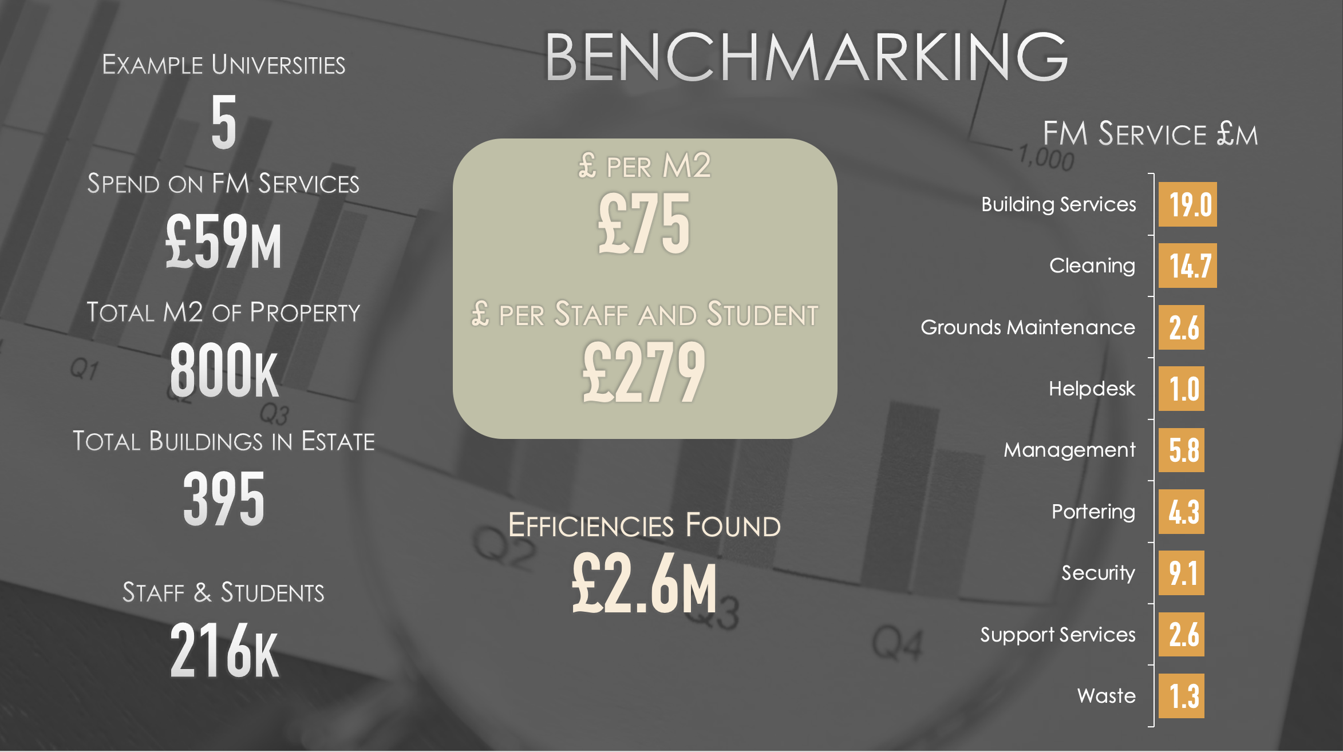
Demonstration
Notes:
Recently, we have had five university clients for whom we have benchmarked their services.
This may have been part of a review, an operational plan or a procurement exercise.
This slide represents a snapshot of the data.
Its an overall 5% reduction of costs

Slide 19
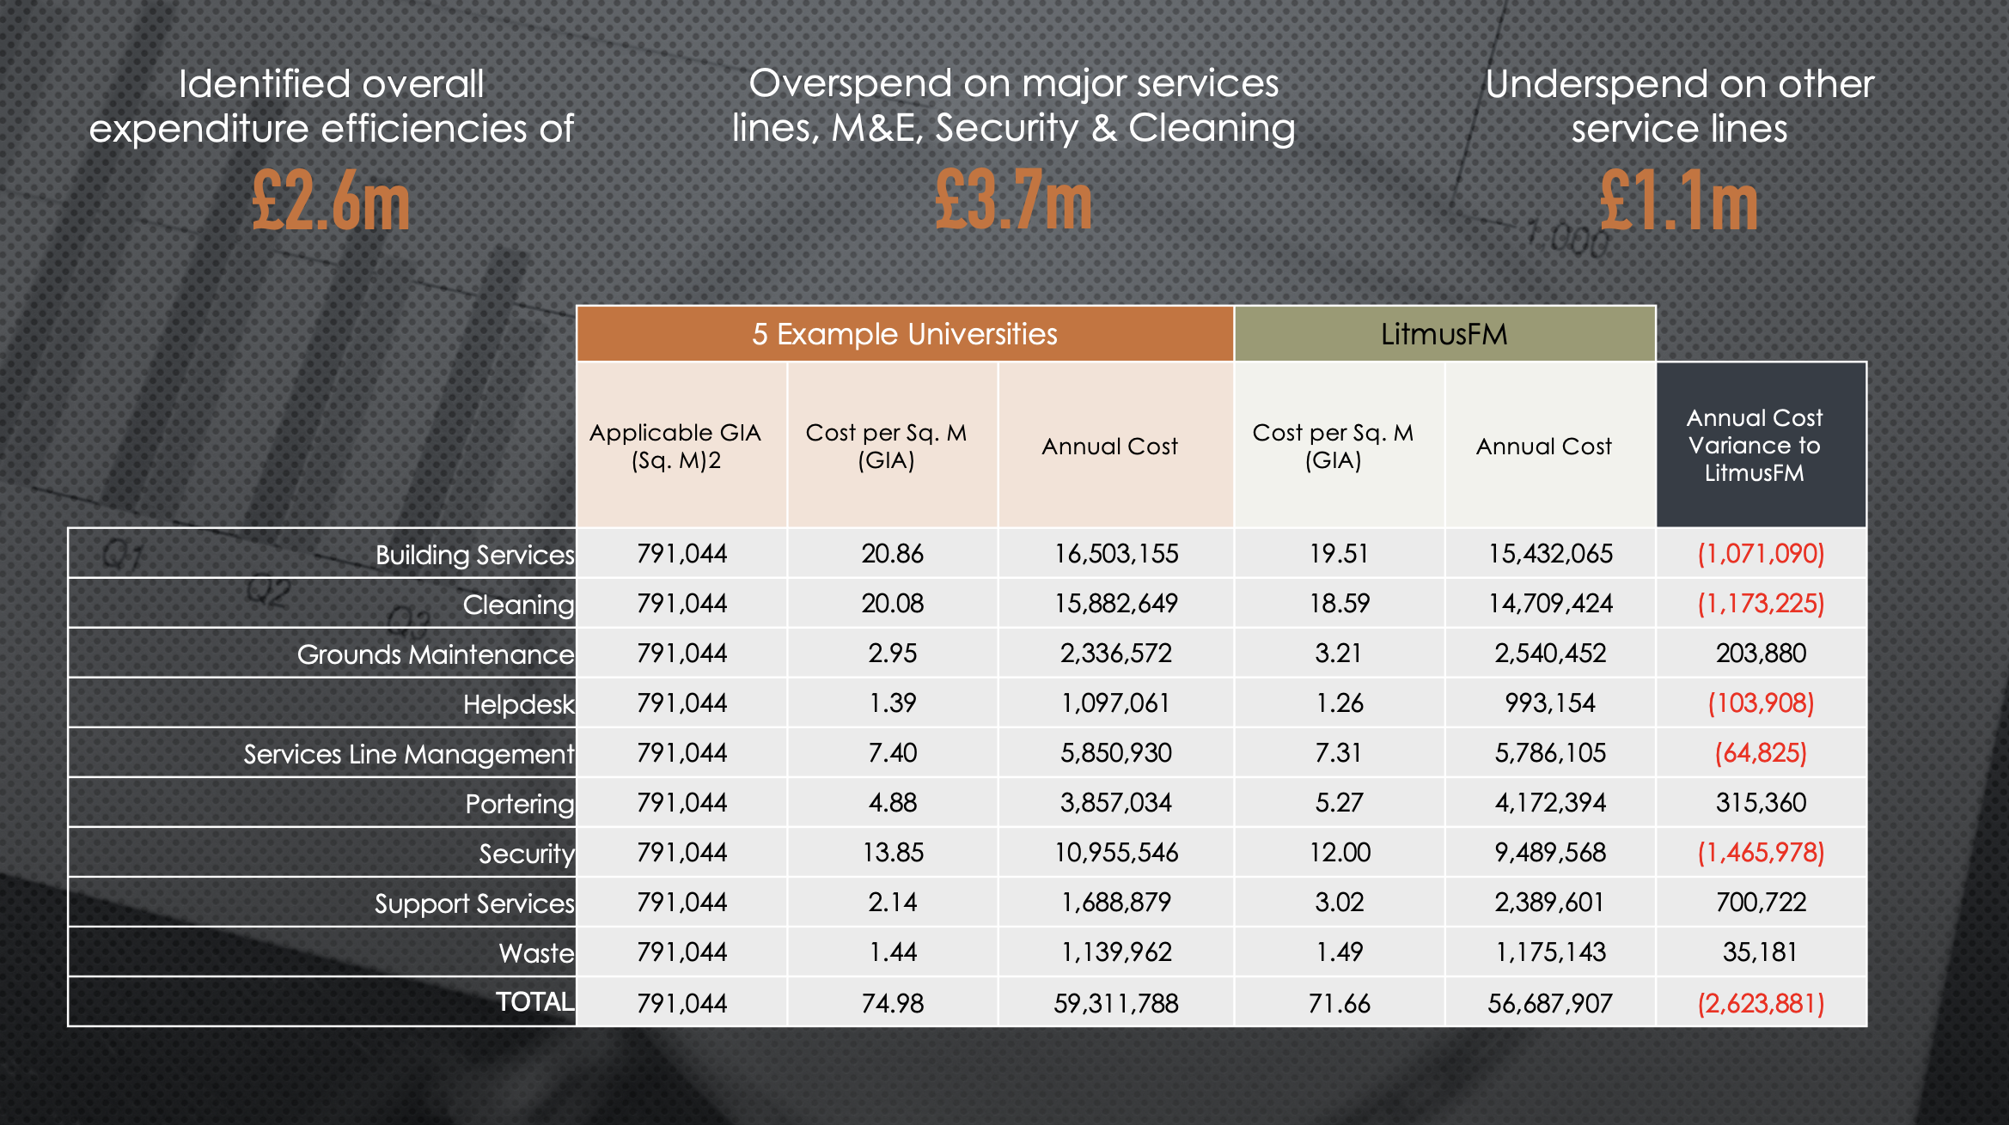
Demonstration
Notes:
In some service lines, our clients are super efficient, or there is no perfect alignment of the services due to specialisms. A good example may be portering. It is hard to align portering in a university against a hospital.
In these cases, we would only align specialist services against those in the same sector, e.g. healthcare to healthcare, University to University.
The same goes for “what's in the support service line”

Slide 20
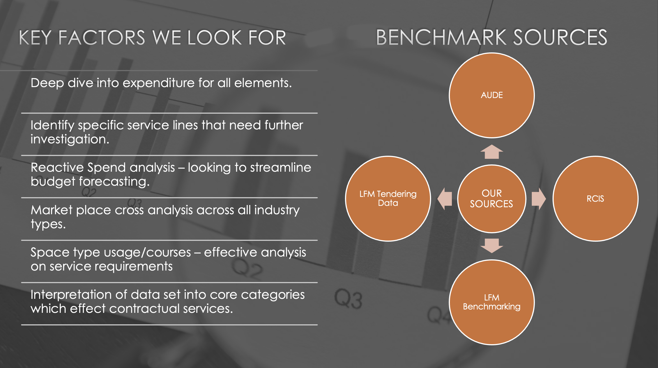
Demonstration
Notes:
We have a tried and tested method on any project which covers four key factors:
Preparation - Here, we gather information to enable the work.
Research - We operationally visit the services. This is much more than a desktop project; we use SMEs in differing FM services to look at what is happening today.
Analysis - We then take our findings away and conduct a forensic analysis of the data and findings to enable reporting.
Report - We provide our clients with fully detailed reports by service line. We then provide our client with recommendations and an options appraisal.

Slide 21

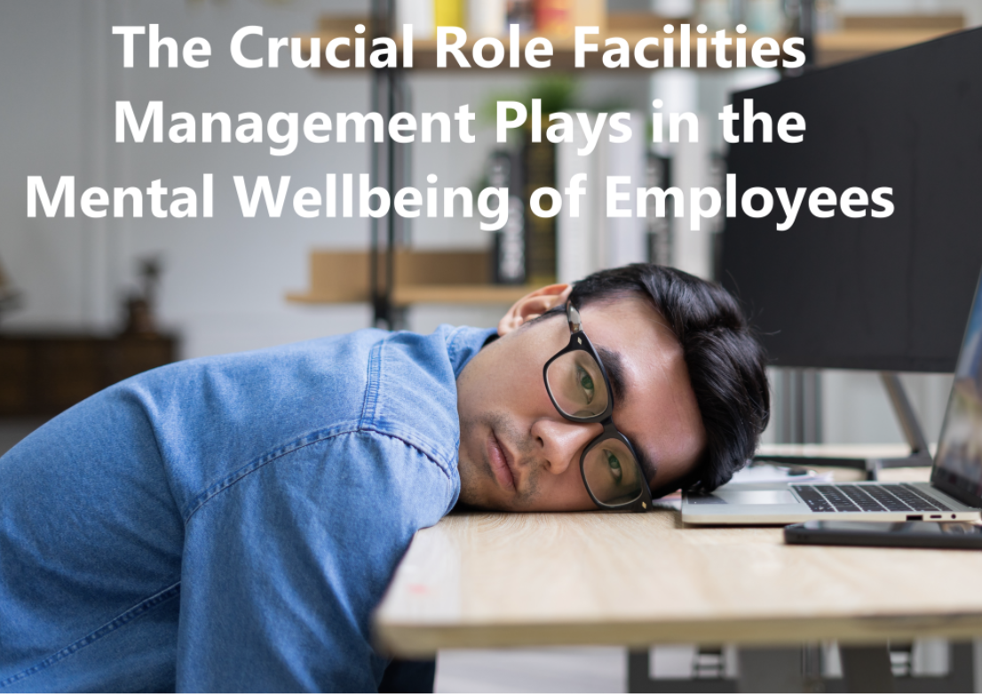

The Great Resignation Will Change Future Workers
The male-to-female ratio in facilities management careers in the UK is approximately 66% to 34%, according to a survey conducted by the Institute of Workplace and Facilities Management (WIFM). The good news is that those numbers are going in the right direction compared to the previous year’s 68% to 32% ratio.
How can Facility Management Enhance Employee and Student Wellbeing and Increase Productivity?
Just like many other industries, FM is grappling with a big issue, there just aren't enough skilled workers to go around. According to a recent RICS UK Facilities Management Survey, as of Q4 2023, some 65% of FM services were having a tough time finding the right people for the job.
Notes:
Gender Gap. It's still an issue, but we're making strides. More and more major players are actively encouraging female workers to join their ranks, offering apprenticeships and promoting through schools, colleges, and universities. This progress is a testament to our collective commitment to gender equality.
Wellbeing
1. Creating open, well-lit, and conducive office spaces: Facility management is not just about building operations and maintenance. Today, FM has the power to shape our work environment, creating an open space with ample natural light (wherever possible) that contributes to a feel-good atmosphere for our valued employees.
2. Making mental health aid easily accessible: While HR plays a crucial role in promoting mental well-being, the FM department can extend this support by ensuring mental health aid is readily available and accessible to our employees. This could be in the form of chat or call options with mental health professionals or by providing professional courses to enhance emotional well-being. By prioritizing mental health, we show our employees that their well-being is our top concern.
3. Ensure Regular Feedback Cycle: Employees often get demotivated when they do not feel heard. It could be their suggestions, doubts about role clarity, or other grievances. Facilities solutions can take a step in this direction and ensure a regular feedback mechanism for the employees that will give the leaders an idea of the areas of improvement. This will keep employees motivated and positive. Emotional well-being requires a holistic approach towards communication between leaders and employees, and FM can act as the bridge to facilitate this two-way communication.
4. Provision of Healthy Food: There is a positive relationship between healthy food and mental well-being. When you stick to a diet of nutritious food, you’re setting yourself up for fewer mood fluctuations, an overall happier outlook and an improved ability to focus. However, lack of time often forces working professionals to eat outside, and the choices available are usually unhealthy. This can be changed by facility managers ensuring that catering facilities provide healthy food options available to employees. Similarly, special care can be taken to ensure hydration by installing water coolers at various points in the office premises.
5. Ensuring the Right Environmental Conditions: We operate more effectively, given the right environmental conditions to work within. This will include light, ventilation and air-conditioning. FM is responsible for ensuring that the environmental conditions are maintained according to the correct design criteria and are conducive to optimum productivity. Furthermore, FM will be responsible for ensuring the safety of employees and occupants within the building. This is particularly true of air conditioning and water hygiene, which, if left unmaintained, can lead to severe issues such as Legionnaires Disease.
6. Facilitating Hybrid Working: The COVID-19 pandemic showed the world that working from home is possible and more instrumental in enhancing productivity and mental well-being. When employees are encouraged to stay in proximity to their families, it motivates them to give their best at work and saves them time for commuting. Today, many companies are opting for a complete work-from-home or hybrid working model, and facility management can step in here to facilitate this change. Concepts like hot desking, the availability of laptops and other work-related gadgets for employees at home, and smooth connections for remote work can guarantee successful hybrid work.

Slide 22
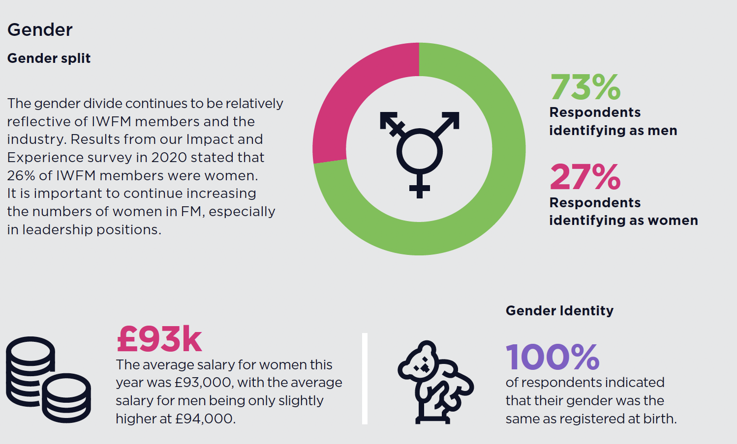
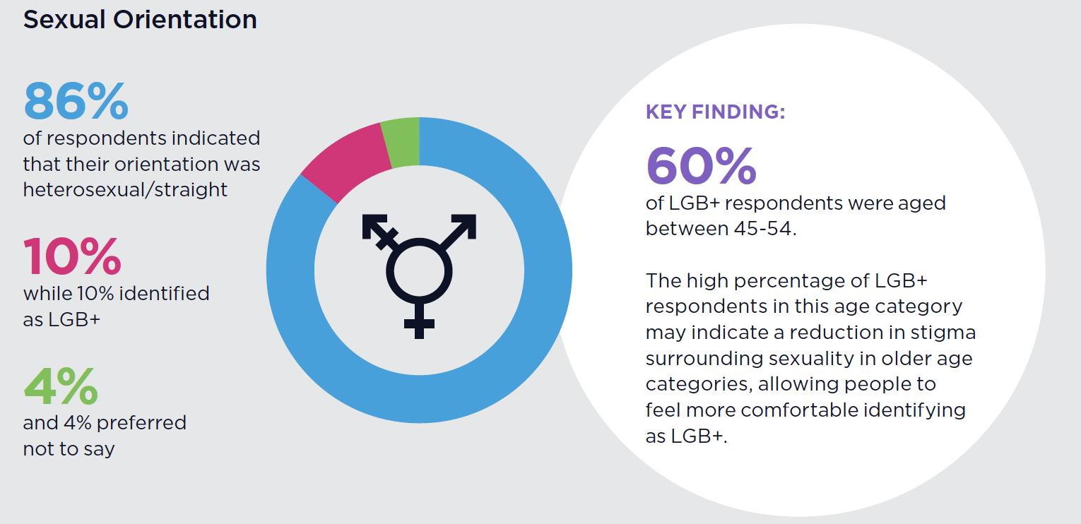
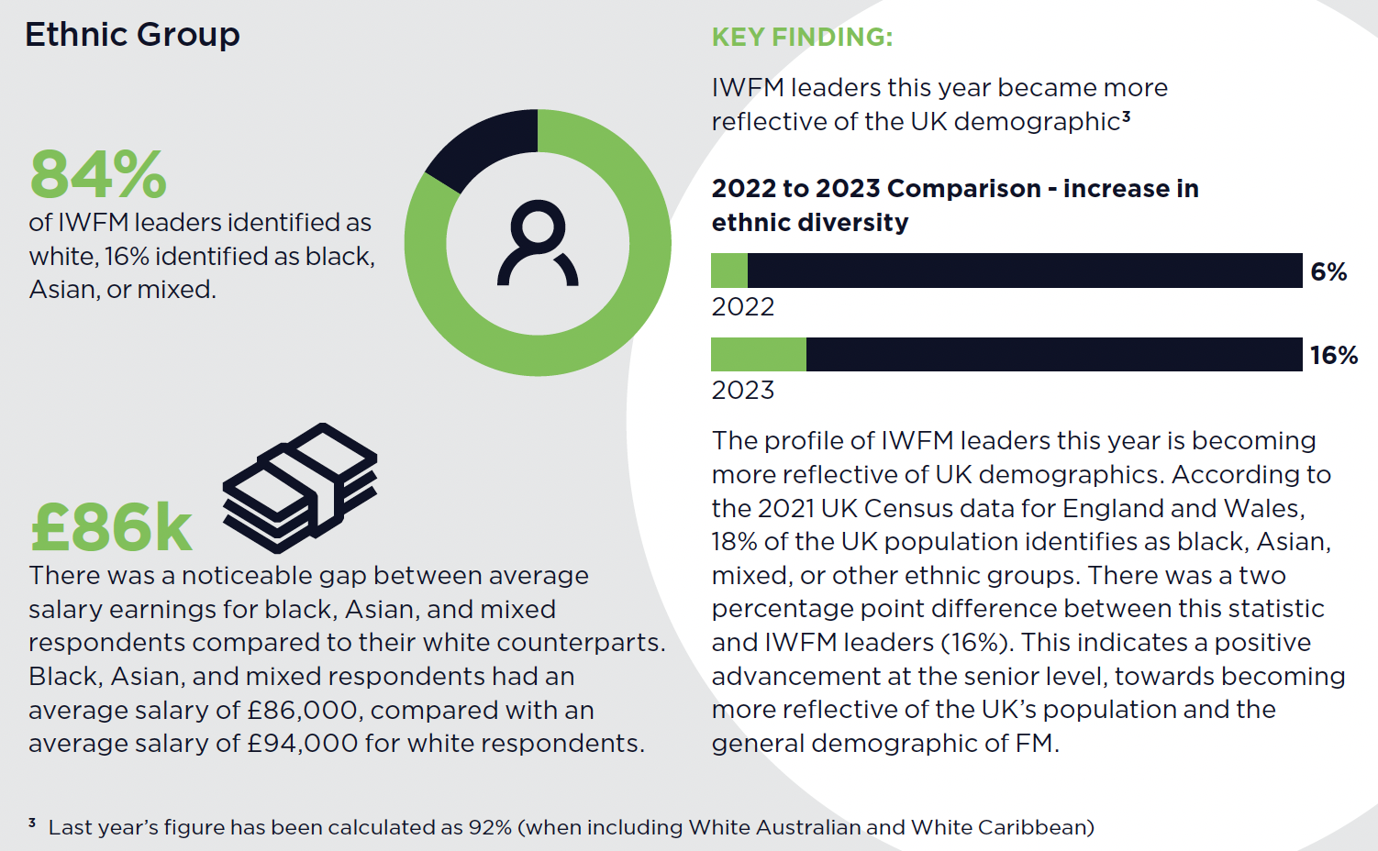
Equality, Diversity and Inclusion
Information from the survey my management in IWFM
Source: IWFM, EDI Governance and Leadership Survey Results 2023
Notes:
It’s great to see positive changes in parts of the sector demographic this year. More diversity makes us better and helps our profession become more inclusive, attractive to all, and innovative through greater diversity of thought.
Yet, it's crucial to note that this is only the second year of the IWFM survey. This limited data hinders our ability to identify clear trends and draw comprehensive conclusions.'
More progress is still needed, which is why we all need to continue improving EDI internally and externally.
The gender split in management has a higher percentage of men than in the full demographic of the FM sector.
Reduction in stigma surrounding sexuality means that more are more comfortable in identifying as LGB+.
In 2021 UK census data for England and Wales, 18% of the population was identified as Black, Asian, Mixed or from other ethnic groups. There is only a 2% difference within the IWFM leadership, which is extremely positive.

Slide 23


What Can We Do Together…
Thought Leadership -Working with AUDE, we take a snapshot of the last EMR Digital and provide measurements against these using the Litmus Benchmarks.
        Working with Bryan on benchmarking cleaning across the sectors with a more granular approach.
We are here to assist your estate team in reviewing any service line. By benchmarking your service against our metrics, we can provide you with a recommendation that will significantly enhance the value you deliver.
Joining more Regional AUDE Directors Meetings and special interest groups.
Notes:
We have agreed to work with Brian to provide a report on cleaning benchmarking by the end of the year. However, we need your help accessing data. We would be grateful if you could provide us with information.

Slide 24




About LitmusFM
We are delighted to join AUDE as your new Business Partner.
Our Business Solutions…
Building Optimisation
Asset Management, Life-Cycle Management and Compliance
Consultancy
TOM, Benchmarking, Audit, Reviews and Procurement
Project Management
Capital Projects, Mobilisation, Moves and
Technology and Reporting
Performance Monitoring, Reporting and Smart technology
We do this by:
Completion of Asset Register
Provision of Lifecycle modelling and Planning resource
Instigate a cloud-based Asset Survey and Management System
Recommendations on remedial works
Statutory Compliance
We do this by:
Creating a new (Target Operating Model): to enable the application of a corporate FM strategy or vision. It is a high-level representation of how a company can be best organised to efficiently and effectively deliver and execute the organisation’s strategy
Team Skills Review Benchmarking
We do this by:
Applying specific processes and principles to initiate, plan, execute and manage the way that new initiatives or changes are implemented within an organisation.
Project Initiation.
Project Planning.
Project Execution.
Project Monitoring and Controlling.
Project Closing.
We do this by:
Track and assess the results of your FM solutions and how they affect your people and the environment around them.
Using smart technology solutions, such as sensors, allows you to take a much more predictive, proactive role as you have a clear picture of everything that’s happening across all your buildings or services.
Notes:
A quick slide on what we do.

Slide 25
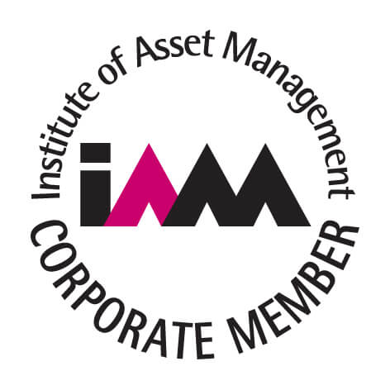









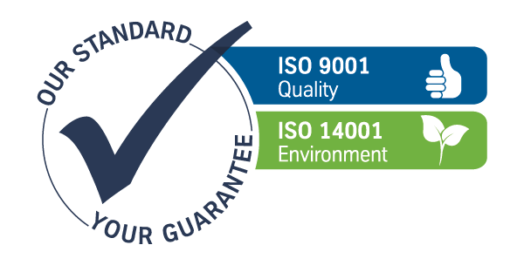

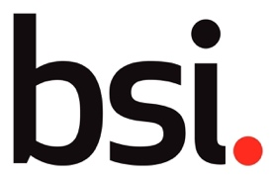

















LitmusFM Capabilities
Experience Standards Capability
Notes:
Our services are delivered to many clients in different sectors and industries.
All have the same fundamental needs: People – Premises – Process.
We use our standards and affiliations to drive new ways of working, innovation and efficiencies.

Slide 26

I would love some questions

